Slide 1
Banking Database Application

Slide 2
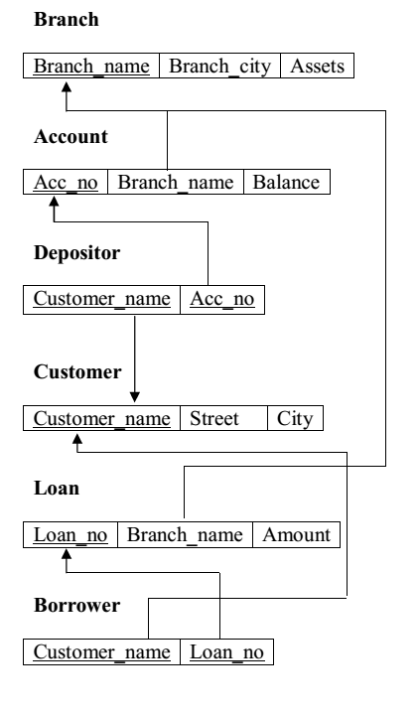
Banking DB Schema

Slide 3
Functionalities
Add Branch Details
Add Customer Details
Create account for registered customers
Add Loan Details
Create Loan Account
Perform operations like credit or debit
View Account details
View Transaction Details

Slide 4
Use case for Admin/Clerk
Add Branch
Add Customer
Admin/Clerk
Add Account
Add Loan
View Details
Generate Reports

Slide 5
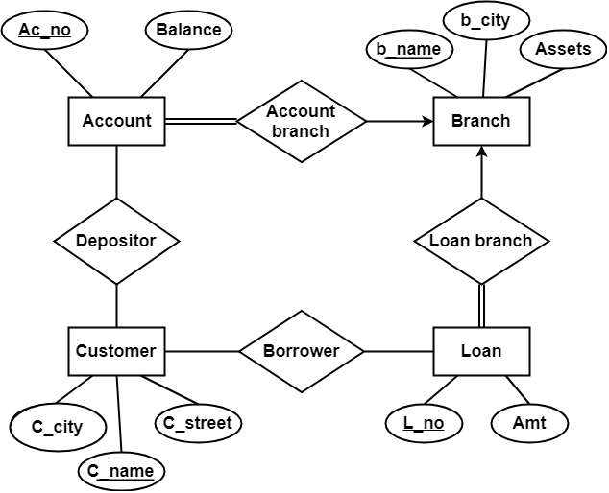
ER Diagram

